Slide 1
Online quiz management
M SAMMY 211801370077
A RAMESH 211801370095
O VISHNU VARMA 211801370101

Slide 2
Abstract
The Quiz Management System offers a user-friendly interface that allows educators and administrators to create, organize, and manage quizzes efficiently. It provides a centralized platform where users can create quiz questions, define scoring criteria, set time limits, and customize quiz settings according to their specific requirements. The system supports various question types, including multiple choice, true/false, fill in the blanks, and essay questions, providing flexibility in designing assessments.

Slide 3
Introduction to Online Quiz Management
Online quiz management is the process of creating, administering, and grading quizzes online. It has become a popular tool for educators and businesses alike as it offers convenience and flexibility.With online quiz management, users can create quizzes with various question types such as multiple-choice, true or false, and short answer. These quizzes can be accessed by users from anywhere with an internet connection, making it easier for students and employees to take them at their own pace.

Slide 4
Existing management
There are several existing applications for quiz management systems that can be used to create and manage quizzes. Here are a few popular options:
Kahoot!: Kahoot! is a widely-used platform for creating and playing interactive quizzes, surveys, and discussions. It offers a user-friendly interface, a vast library of pre-made quizzes, and allows for customization of questions and formats.
Quizizz: Quizizz is another popular platform that allows users to create and play quizzes. It offers features like real-time multiplayer quizzes, student-paced mode, and a library of pre-made quizzes.

Slide 5
Disadvantages of existing application
There can be several disadvantages of existing quiz management systems. Here are a few commonly observed drawbacks:
Limited customization: Some quiz management systems may lack flexibility in terms of customization options. Users may not have the ability to tailor the system to their specific needs, such as branding or adding custom features.
Lack of scalability: Certain quiz management systems may have limitations in handling a large number of participants or quizzes simultaneously. This can result in system slowdowns or crashes during peak usage periods.

Slide 6
Proposed application
An application for quiz management can be a useful tool for organizing and administering quizzes or exams. Here's a proposed outline for the application:
User Management:
Allow administrators to create accounts and manage user roles (admin, teacher, student).
Provide authentication and authorization mechanisms to ensure secure access.
Quiz Creation:
Enable teachers or administrators to create quizzes with customizable settings.
Support different question types, such as multiple choice, true/false, fill in the blanks, etc.
Question Bank:
Maintain a question bank where teachers can store and organize questions for future use.
Allow categorization and tagging of questions for easy retrieval.

Slide 7

Advantages of proposed application
Centralized Management
Accessibility
Time Efficiency
Flexibility and Customization
Real-time Feedback
Data Analysis

Slide 8
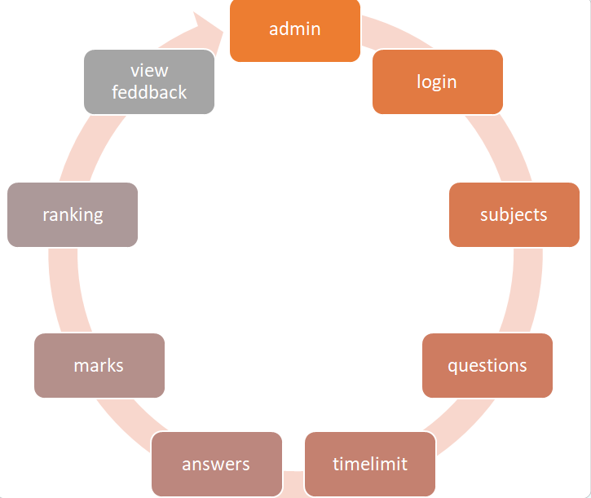
Application Flow chart

Slide 9
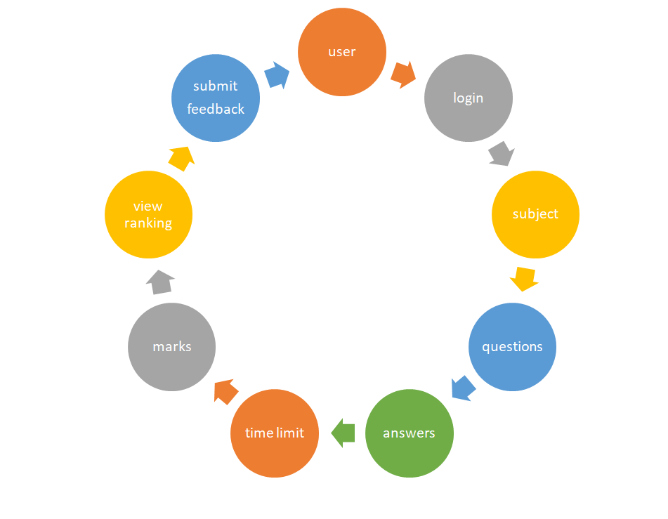
Users flow chat

Slide 10

Quiz management system project interface

Slide 11
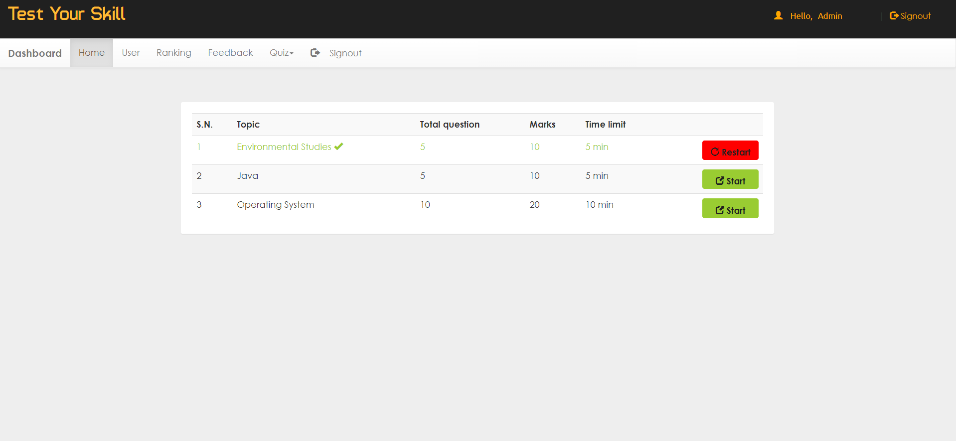
Admi pannel

Slide 12
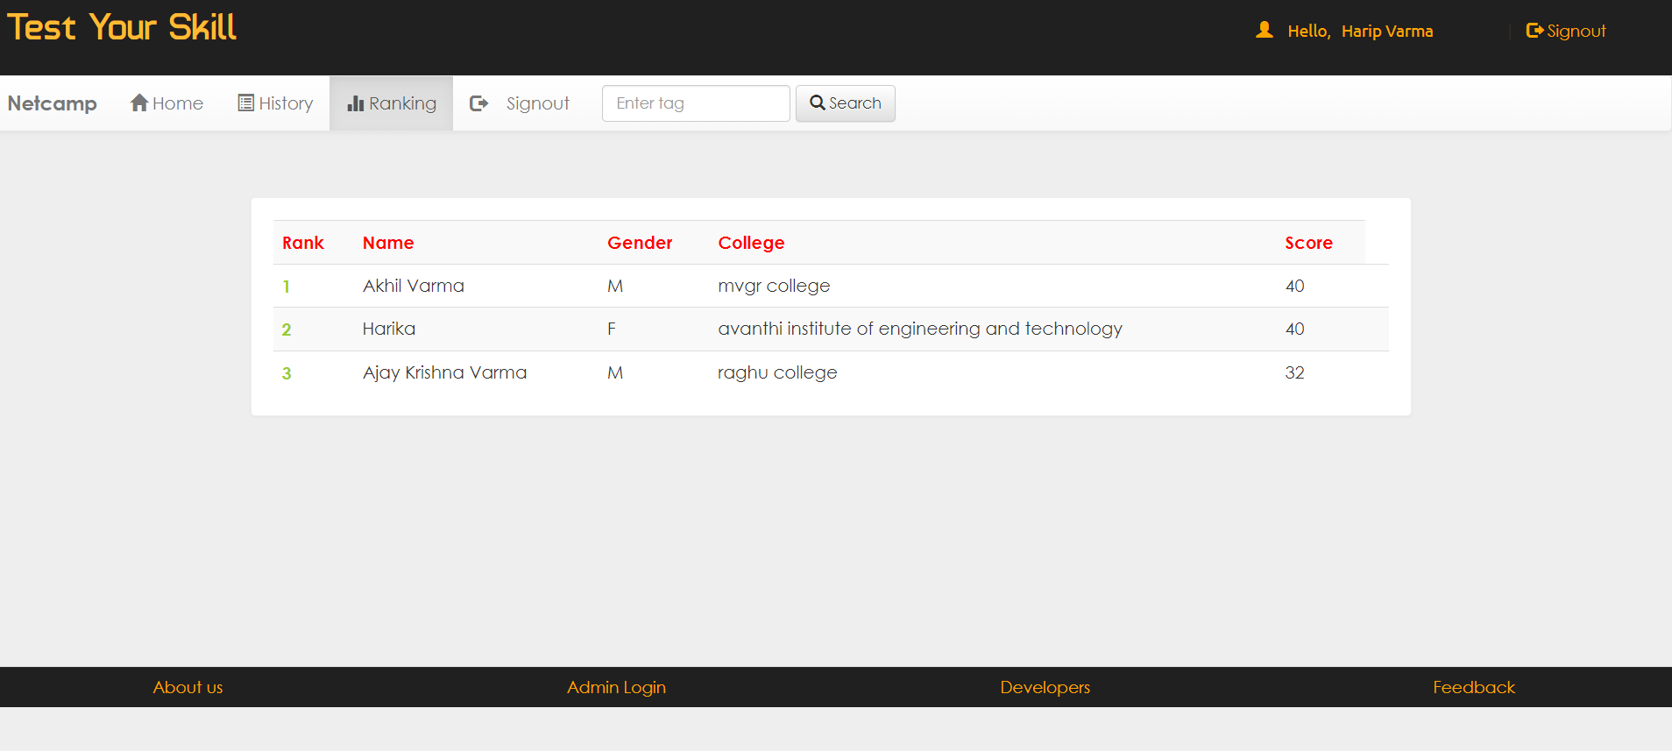
Users pannel

Slide 13
Users layout

Slide 14
conclusion
Overall, online quiz management offers many benefits for educators and businesses looking to create and administer quizzes. With its convenience, flexibility, and automated grading, it can save time and improve accuracy. However, it is important to consider the potential challenges and ensure proper training and support for users.As technology continues to advance, it is likely that online quiz management will become even more sophisticated and user-friendly, making it an increasingly valuable tool for education and assessment.

